Slide 1
Multivariate Statistical Methods for Computing a Small-Scale Fisheries Vulnerability Index

Slide 2
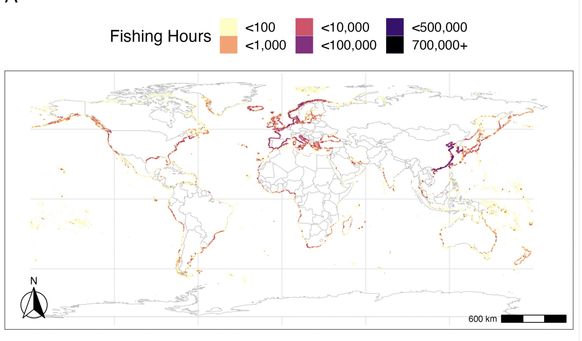
Background - Small Scale Fisheries
Small Scale Fisheries (SSF)
Livelihoods
492 million people at least partially dependent on SSF
90% of capture fisheries employment
Food
37 million tons of fish caught
40% of global fisheries catch
Overlap
83.7% of SSF is less than 20 kilometers from shore, where large scale fisheries also work

Slide 3
Background - Data and Research Question
Research Questions
Broad
What are the food security impacts of large- and small-scale fisheries spatial overlap.
Specific
Within the spatial area of <20km from shore, which countries have high vulnerability to LSF-SSF interactions
How much nearshore LSF activity occurs in proximity to SSF locations
Data
Global Fishing Watch
Industrial fishing effort
Illuminating Harvests (SSF data)
National Indicators
Governance scores
World Bank Data

Slide 4
Overview of Proposed Recommendations
Principal Components Analysis (PCA)
Factor Analysis (FA)
Structural Equation Models (SEMs)
For weighting
Variable Choice, Transformation, and Evaluation

Slide 5
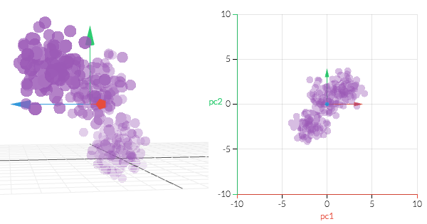
Principal Component Analysis (PCA)
Widely applicable statistical method to reduce the dimensionality of a large data set by reducing the number of variables while retaining most of the information they encompass
Key assumptions:
Original variables must be correlated
There must be a linear relationship among the variables
Variables must be standardized and centered
PCA is not robust against outliers
Calculation requires no missing data values

Slide 6
PCA Calculation Guidelines
Calculation
Ordering
Interpretation
Standardize variables
Compute covariance matrix
Calculate eigenvalues
Rank eigenvalues in descending order
Decide percentage of original variance to explain in PC’s
Quantify number of PC’s necessary for analysis
Assess if a linear relationship exists
Create composite index
Calculate all PC component indices based on eigenvalues
Create composite summation
Display in ordinal format

Slide 7
Advantages to Using PCA as a Tool to Construct a Composite Index
Dimensionality reduction!
Excellent mathematical properties
Index obtained from first principal component (usually) explains large portion of variance
Makes interpretability easier
Notes:
Dimensionality reduction: reduces the number of variables while retaining most of the information they encompass
The PCA has a number of excellent mathematical properties - most importantly that the index obtained from the first principal component explains the largest portion of variance of the individual indicators. When these PCA indices capture a large amount of the variance and make analysis more interpretable it is an extremely useful tool. However, when the first principal component accounts for a limited part of the variance in the data, we can lose a consistent amount of information. Moreover, the PCA based index is often elitist, with a strong tendency to represent highly intercorrelated indicators and to neglect the others, irrespective of their possible contextual importance. This poses a significant challenge for PCA-based asset indices, emphasizing the importance of ensuring a diverse range of asset variables to prevent issues related to clumping or truncation. In addition, it is often the case that the weights assigned to variables in PCA might be similar, leading to the equal weighting of variables in the composite index that may lack a clear and intuitive interpretation in terms of the original variables. Although PCA is quite useful in its dimensionality reduction, the procedure is by no means ‘perfect’ for deriving composite development indices and is often very case specific.

Slide 8
Disadvantages to Using PCA as a Tool to Construct a Composite Index
Can lose a significant amount of information
First component dependent
PCA based index is often elitist
"Elitist" implying a bias towards highly intercorrelated indicators, neglecting less correlated ones, thus favoring a select subset in representation
Weights assigned to variables in PCA might be similar, leading to the equal weighting of variables in composite index lacking clear and intuitive interpretations
Linearity assumption
Notes:
The PCA has a number of excellent mathematical properties - most importantly that the index obtained from the first principal component explains the largest portion of variance of the individual indicators. When these PCA indices capture a large amount of the variance and make analysis more interpretable it is an extremely useful tool. However, when the first principal component accounts for a limited part of the variance in the data, we can lose a consistent amount of information. Moreover, the PCA based index is often elitist, with a strong tendency to represent highly intercorrelated indicators and to neglect the others, irrespective of their possible contextual importance. This poses a significant challenge for PCA-based asset indices, emphasizing the importance of ensuring a diverse range of asset variables to prevent issues related to clumping or truncation. In addition, it is often the case that the weights assigned to variables in PCA might be similar, leading to the equal weighting of variables in the composite index that may lack a clear and intuitive interpretation in terms of the original variables. Although PCA is quite useful in its dimensionality reduction, the procedure is by no means ‘perfect’ for deriving composite development indices and is often very case specific.

Slide 9
Exploratory and Confirmatory Factor Analysis
Method to define a weighting scheme to form composite indicators
Based on a collection of linear models for the measured variables given a set of unobserved (latent) factors (Nardo, et. al)
Exploratory Factor Analysis used for latent variable identification and data reduction
Confirmatory Factor Analysis starts with hypothesized weights and assesses its goodness of fit

Slide 10
Factor Analysis Guidelines
Factor analysis relies on several assumptions for accurate results:
High-quality data measured on interval scales
Some correlation between variables
Data that are distributed in a multivariate normal fashion
Not necessarily a strict assumption
Assumes linear relationships between variables (i.e., linearity)
Relatively large sample size
General guidelines:
Between 5:1 and 10:1 participants-to-variables ratio
Sample size greater than 100-200
If sample size is smaller than that, adequate solutions can still be obtained with a greater participants-to-variables ratio
Notes:
Factor analysis relies on several assumptions for accurate results. Violating these assumptions may lead to factors that are misleading or hard to interpret. In general, the most basic requirement for optimal use of factor analysis is high-quality data that are measured on interval, with some correlation between variables.
Ideally, these data would also be distributed in a multivariate normal fashion. For certain methods of parameter estimation, like maximum likelihood factor analysis, multivariate normality is a strict assumption. In contrast, others, such as the principal axes (or least squares) method–which is by far the most commonly used approach for exploratory factor analysis–do not require or assume multivariate normality. However, both exploratory and confirmatory factor analysis appear to be relatively robust against violations of normality in practice.
Another key assumption in factor analysis is linearity. This means that the relationships among variables are assumed to be linear, ensuring that changes in values are consistent
Finally, it is important to note that larger sample sizes ensure more stable estimates of factor structure. While explicit guidelines have always been in flux, experts typically recommend a minimum participants-to-variables ratio of between 5:1 and 10:1, and an overall sample size greater than 100-200. When the sample size is smaller than that, adequate solutions can still be obtained with a greater participants-to-variables ratio.

Slide 11
Advantages of Factor Analysis
Hypothesis generation
Data reduction
Reduces the “dimensions” (number of variables) of the data into one or more “super-variables” (i.e., latent variables)
Uncovers hidden patterns
Highlights key elements that contribute most to variability in the dataset
Particularly valuable in cross-country analyses
Loading-based weighting
Assign composite index variable weights based on the strength of association outputted by factor analysis
Notes:
Factor analysis, particularly Exploratory Factor Analysis (EFA), is beneficial for hypothesis generation when researchers have no pre-existing hypotheses about the underlying factor structure of the data. By identifying the factors which are responsible for the correlations among a set of variables, EFA can reveal underlying patterns and structures in the data that aren’t immediately apparent. This can be helpful in deciding what variables to include in a composite index.
Additionally, EFA excels at data reduction and simplification, reducing complex datasets into more easily understandable and interpretable "super-variables". This is especially beneficial in fields like psychology, sociology, and market research where identifying latent constructs is vital.
EFA is also particularly valuable in cross-country analyses, highlighting key elements that contribute most to variability in the dataset, and are thus more likely to yield insights in comparative studies such as yours.
With regard to creating a composite index, one method to consider would be loading-based weighting, where weights are assigned based on the factor loading of each variable (i.e., a higher loading means a higher weight for that variable).

Slide 12
Disadvantages of Factor Analysis
Sensitive to small sample sizes, outliers, and basic changes in foundational data
Assumes linearity, no bias in selecting sub-indicators, use of interval data, multivariate normality, underlying dimensions, and strong intercorrelations
Correlations don’t necessarily convey true influence of sub-indicators on issue being studied
Notes:
In terms of disadvantages, factor analysis is sensitive to small sample sizes, basic changes in foundational data, and especially the presence of outliers, because outliers can contribute to the identification of additional factors or obscure the presence of genuine factors, which can lead to overfitting or underfitting of the model. This can end up skewing the weights assigned to different components of the index, and can end up compromising the reliability of the composite index.
Factor analysis makes a large amount of assumptions, including assuming linearity, the use of interval data, multivariate normality, and underlying dimensions. And the assumption that factor analysis assumes there is no bias when selecting sub-indicators is especially impactful because this assumption can lead to skewed weightings if specific relevant indicators are overlooked or if included indicators are not representative of the dimensions they are supposed to measure.
And it also assumes there are strong intercorrelations, because conducting factor analysis on a dataset with very little intercorrelation means that there are almost the same amount of factors as there are original variables, which defeats the entire purpose of factor analysis. This can lead to a composite index where the weights do not accurately represent the underlying structure of the data, thus questioning the validity and utility of the index.
Another disadvantage is that the correlations don’t necessarily represent the real influence of the sub-indicators on the problem being measured because it doesn’t provide you much information about the direction of influence in bidirectional relationships. This can lead to misinformed weighting decisions, where the influence of certain indicators might be either overstated or understated.

Slide 13
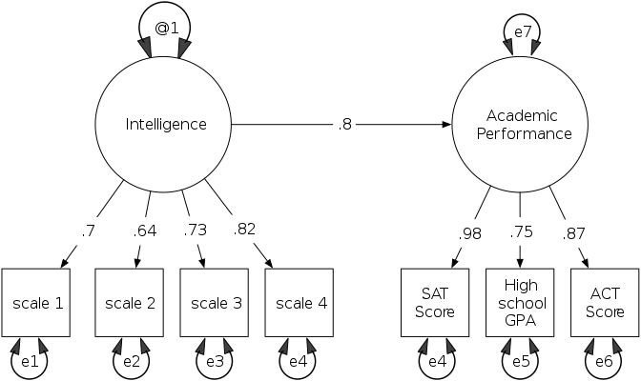
Structural Equation / Path Models (SEMs/PLS-PMs)
SEM
Allows for explanation of relationships between latent variables.
Useful for testing hypothetical variable structures.
PLS-PM
Variant of SEM that can fit composite models.
Useful for small sample sizes, missing data, or non-normal distributions.
Notes:
composite model: indicators build up the construct (adaptive capacity is created by governance, rule of law, etc)
factor model: construct causes the indicators (ex. there is this latent variable that exists called adaptive capacity, and countries with low values of this variable will exhibit low governance. or intelligence may be an underlying factor influencing measured variables like iq score and gpa, but intelligence is not created by iq score and gpa.)

Slide 14
Using SEMs to construct composite index and subindexes
Define the latent constructs or factors
Ex: Exposure, Sensitivity, Adaptive Capacity
Choose observed variables related to each construct and load their factors in the SEM.
This step involves specifying the measurement model, ensuring that the indicators effectively represent the latent constructs.
Specify the relationships and paths between the latent constructs.
The resulting SEM provides a comprehensive framework for constructing the composite index and subindexes, incorporating both the measurement and structural aspects of the model.

Slide 15
Guidelines for SEMs
Use Cases:
Used to confirm factorial structure by modeling latent constructs (factors) and their relationships with observed variables.
For both exploratory (model-building) and confirmatory (hypothesis-testing) modes.
Handles complex data structures in composite indicator construction.
Tips:
They are simplified representations; important factors may be omitted.
Require adequate data quality and relatively large sample size (5-20 observations per model parameter)
Given the small sample size of around 100 countries with SSF, it is recommended to use fewer than 20 parameters.
Since the 3 Components are counted as well, ideally only up to 17 variables should be used.
Notes:
Tips pt2: a problem since SSF components have

Slide 16
Guidelines for PLS-PMs
A method of structural equation modeling
Use Cases:
For estimation of complex cause-effect relationships in path models
Takes further advantage of latent variables
When the focus is on prediction rather than hypothesis testing
PM optimizes the estimation of the LVs
Minimally constrained by low sample size, missing data, multicollinearity or non-normal data distributions
Key things to note:
Relatively recent development
Effectiveness in low sample size situations still being questioned by some methodological researchers (Sarstedt, et. al 2016)
Notes:
A hammer is a suboptimal tool to fix screws, PLS is a suboptimal tool to estimate common factor models (Henseler, 2014)

Slide 17
Pros and Cons of SEMs/PMs for Index Creation
Advantages:
Deals well with multivariate data with many features. Can relate errors between multiple variables.
Robust to Missing Data, since it uses raw data and not summary statistics
Works with longitudinal data- time series, growth data, etc.
Uses latent variables for composite index variables, a good way to approximating the real variables
Disadvantages
Multivariate Data means we need a larger sample size/ dataset
Must ensure 5-20 observations for each model parameter
Relationships determined are not causal
Latent variables are only an approximate of the real variable- different variance
Before fitting model, you need to check if model is identified by the data- that is, if there are not multiple sets of parameters that produce the same covariance matrix.
Must check the t-rule, scale latent variables, and have sufficient indicators

Slide 18
Choice of Informative Variables
Variable Importance (Part of Composite Indices)
Weighting of variables in order to aggregate the variables into an index
Identify impact of individual variables on overall index score
Crucial for policymakers
Provides insights into key drivers of the index
Can inform targeted interventions or policy changes
Nominal weights vs. Importance
Concept of importance of a given indicator is based on correlation between
The original composite index (OCI) which includes the examined indicator
The modified composite index (MCI) which excludes the examined indicator
Correlation coefficient between the nominal weight and the importance of indicators in paper’s sample is 0.52 (Schlossarek et al., 2019)
A moderately strong relationship
Not a perfect correlation as expected
Notes:
Group E - Gorden

Slide 19
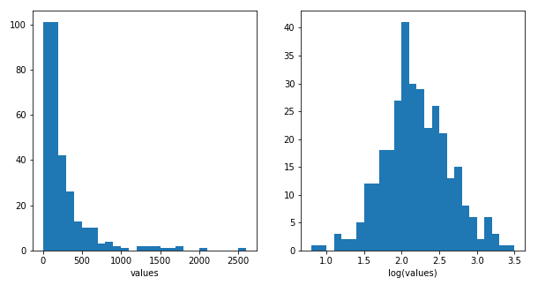
Variable Transformation – Scaling
Normalization
Deals with variables with different measurement units.
Addresses scale & distribution issues.
Scaling Techniques
Ratio Scale
f : x→ y = α x; α > 0
E.g. Yards to Centimeters, 1 yd = 91.44 cm
Interval Scale
f : x→ y = α x + β; α > 0, β ≠ 0
E.g. Celsius to Fahrenheit, y(°F) = 9/5 x (°C) + 32
Logarithmic Transformation
f : x→ y = log(x); x > 0
Higher shrinkage for higher values.
Commonly used for data (non-negative) with wide ranges or skewness.
(Nardo et al. 44-53)
Log Transformation
Notes:
Group E - Ken

Slide 20
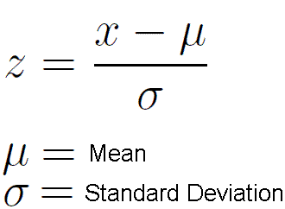

Variable Transformation – Other Normalization Methods
Standardization (Z-Scores)
Mean of 0, SD of 1.
When: linear models, neutral networks, algorithms assuming normal distribution.
Re-scaling
Transformation based on range rather than SD.
Identical range (0 to 1).
Outliers have distortion effect.
When: want data in specific range.
Ranking
Assigns a rank to each value, creating a relative ordering.
E.g. smallest value gets rank 1, second smallest gets rank 2, etc.
Pro: independence to outliers.
Con: lose info on absolute levels.
When: algorithm requires ordinal information rather than numerical values.
(Nardo et al. 44-53)
Notes:
Group E - Ken

Slide 21
Techniques for Index Evaluation
Uncertainty Analysis (UA): UA examines how uncertainty in inputs affects the CI values
Monte Carlo involves generating many sets of weights and applying different normalization methods
The output of these simulations is a set of values for the composite indicator
This set is analyzed statistically to understand the distribution of the composite indicator
Variable Importance: This analysis helps in determining which variables contribute most significantly to the composite index
Identifies discrepancies between nominal weights and actual impact
Sensitivity Analysis (SA): SA focuses on the contribution of each uncertainty source to the output variance
Variance-based techniques (i.e. Sobol Index, Total Effect Index) are employed
Quantify the importance of different factors
Notes:
Group E - Ejay
Characterized by metrics such as mean, variance, and confidence intervals
Uncertainty Source: Weighting and aggregation, indicator selection, normalization methods
For instance, if a particular weight has a high first-order Sobol index, it means that this weight alone, without considering its interactions with other weights, significantly influences the composite indicators variance
Sobol: input and its contribution to the variance of the output
Total Effect: input as well as its interactions and its contribution to the variance of the output

